Slide 1


JavaScript Runtime & Fundamentals
Nagaraju Katta July 21, 2021

Slide 2


Today’s Agenda
Execution Contexts
JavaScript Call Stack
Event Loop
Variable Scopes
Hoisting
Variables
Data types

Slide 3
JavaScript Execution Contexts
Execution context : When JavaScript engine executes a script, it creates execution contexts. Each execution context has two phases :
Creation phase
Execution phase

Slide 4
The creation phase
When a script executes for the first time, the JavaScript engine creates a Global Execution Context. During this creation phase, it performs the following tasks
Create a global object i.e window in the web browser or global in Node.JS
Create a this object binding which points to the global object above
Setup a memory heap for storing variables and function references
Store the function declarations in the memory heap and variables within the global context with the initial values as undefined

Slide 5
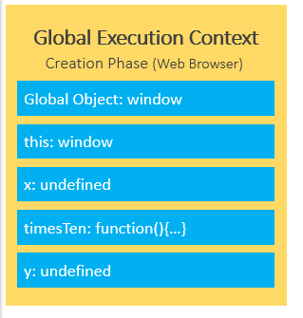
Global Execution Context

Slide 6
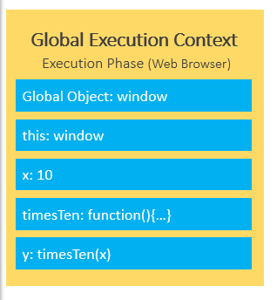
The execution phase
During the execution phase, the JavaScript engine executes the code line by line. In this phase, it assigns values to variables and executes the function calls.
For every function call, the JavaScript engine creates a new Function Execution Context

Slide 7
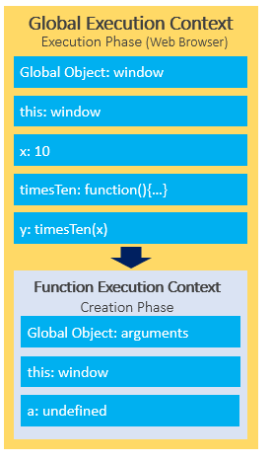
Function Execution Context

Slide 8
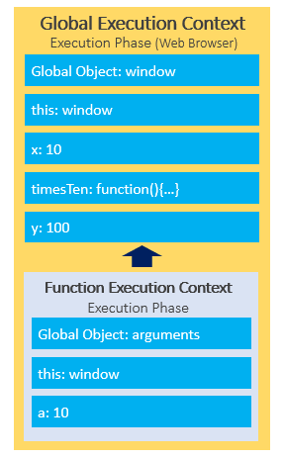

Slide 9
JavaScript call stack
JavaScript engine uses a call stack to manage execution contexts: the Global Execution Context and Function Execution Contexts
The call stack works based on the LIFO principle i.e, last-in-first-out
When you execute a script, the JavaScript engine creates a Global Execution Context and pushes it on top of the call stack.
Whenever a function is called, the JavaScript engine creates a Function Execution Context for the function, pushes it on top of the Call Stack, and starts executing the function.
The script will stop when the call stack is empty.

Slide 10
Asynchronous JavaScript
JavaScript is the single-threaded programming language. The JavaScript engine has only one call stack so that it only can do one thing at a time.
When executing a script, the JavaScript engine executes code from to bottom, line by line. In other words. It is synchronous.
Asynchronous is the opposite of synchronous, which means happening at the same time.

Slide 11

How does JavaScript carry asynchronous tasks ?

Slide 12
JavaScript Event Loop
JavaScript single-threaded model : JavaScript is a single-threaded programming language. In other words, it can do only one thing at a time.
JavaScript engine executes a script from the top and works its way down creating execution contexts and pushing and popping functions onto and off the call stack.
Blocking functions : A function that takes a long time to execute is known as a blocking function. Technically, the blocking functions block all the interactions with the webpage such as mouse click.

Slide 13
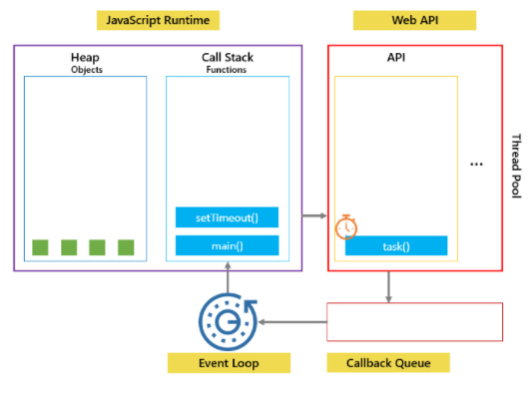
Callbacks to the rescue
To prevent blocking functions from blocking other activities, we typically wrap them in callback functions which can be executed later.

Slide 14
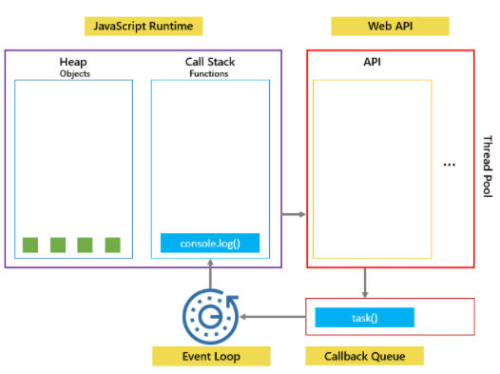

Slide 15
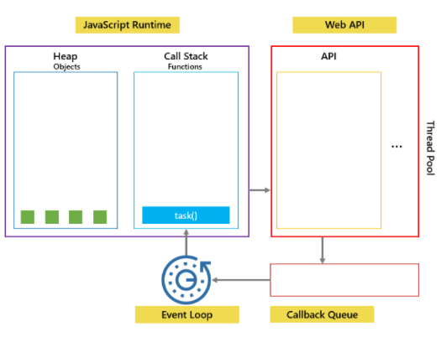

Slide 16
JavaScript variable scopes
Scope determines the visibility and accessibility of a variable.
JavaScript has three scopes :
Global scope : JavaScript engine assigns variables that you declare outside of functions to the “Global execution context”. These variables are in the global scope. They are also known as global variables.
Local scope : Variables that you declare inside a function are local to the function. They are called local variables.
Block scope : Generally, whenever you see curly brackets {}, it is a block. Variables that you declare inside a block are block scoped variables.

Slide 17
Scope chain & Global variable leaks
Scope chain: The way that JavaScript resolves a variable by looking it in its current scope, if it cannot find the variable, it goes up to the outer scope, is called the scope chain.
Global variable leaks : the weird part of JavaScript
Memory leaks : Memory leaks can be defined as memory that is not required by an application anymore that for some reason is not returned to the operating system or the pool of free memory.
Today’s reading assignment : Write types of memory leaks in JavaScript and how to get rid of them.

Slide 18
JavaScript Hoisting
During the creation phase, the JavaScript engine moves the variable and function declarations to the top of your code. This feature is known as hoisting in JavaScript.
Variable Hoisting : Variable hoisting means the JavaScript engine moves the variable declarations to the top of the script
Function Hoisting : Like variables, the JavaScript engine also hoists the function declarations. It moves the function declarations to the top of the script

Slide 19
JavaScript Variables
JavaScript variables are loosely types, that is to say, variables can hold values with any type of data.
Variables are just named placeholders for values.

Slide 20
JavaScript Data Types
JavaScript is a dynamic language or loosely typed therefore a variable doesn’t associate with any type.
In other words, the same variable can hold values of different types at any time
Six primitive data types
null , undefined, boolean, number, string, symbol – available only from ES6
Complex data type
object

Slide 21
Home work

